Slide 2
Capital: Phnom Penh City
Population: 16 million people
Religion: 95% Buddhism
Official language: Khmer
Local Currency: Riel and Dollar
Borders: Thailand, Laos and Vietnam
The most popular destination:
Siem Reap City
Phnom Penh City
Kep
Rantanakiri
Sihanoukville (Beach)

Slide 3
Video clip
Notes:
Video clip

Slide 4
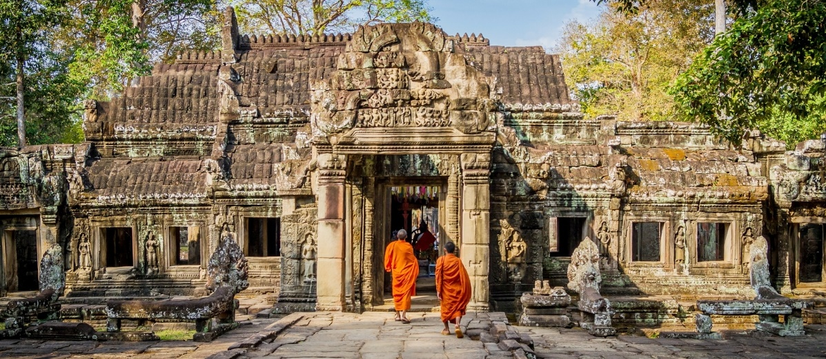
SIEM REAP CITY
Notes:
SIEM REAP CITY, a resort town in Cambodia, is the gateway to the ruins of Angkor, the seat of the Khmer kingdom from the 9th–15th centuries.
Location: Northwest of Cambodia
Activities:
Visit the highlights temples: Angkor Wat, Angkor Thom and Ta Prohm
Take a boat ride on Tonle Sap Lake to visit floating villages
Hiking to Kbal Spean ‘the River of a Thousand Lingas’
Flying over Angkor by helicopter
Visit the Khmer villages by bike
Meet a Pol Pot survivor
Blessing ceremony in monastery
Visit Khmer dance school
Meet well-known Khmer artist
Learn to prepare and cook delicious Khmer cuisine
Catering an Exclusive dinner amid secluded rice field

Slide 5
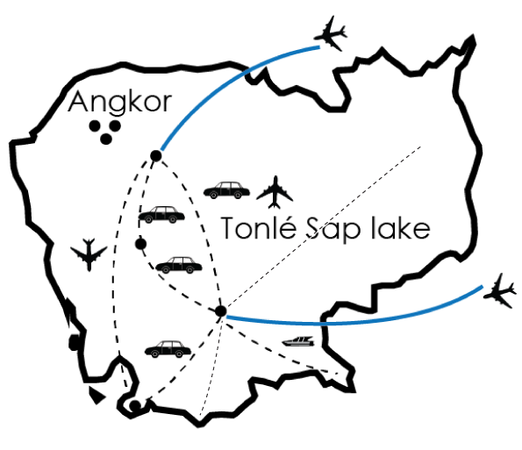
Rantanakiri
Siem Reap
Battambang
Phnom Penh
Kep
Sihanoukville

Slide 6
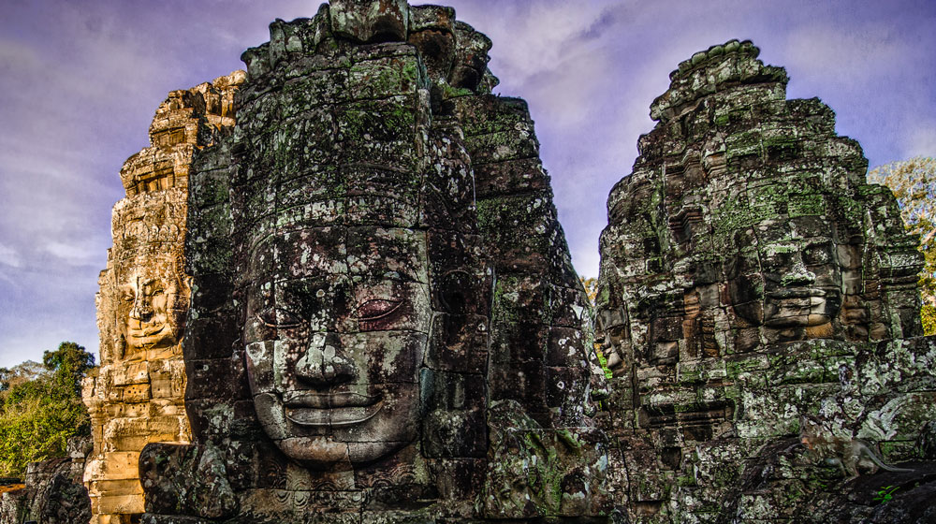
ANGKOR THOM TEMPLE
Notes:
Activities:
Visit Angkor Thom temple, is a microcosm of the universe, divided into four parts by the main axes: Bayon, Baphuon, the Royal Enclosuthe highlights temples: re and the Terrace of Elephants

Slide 7
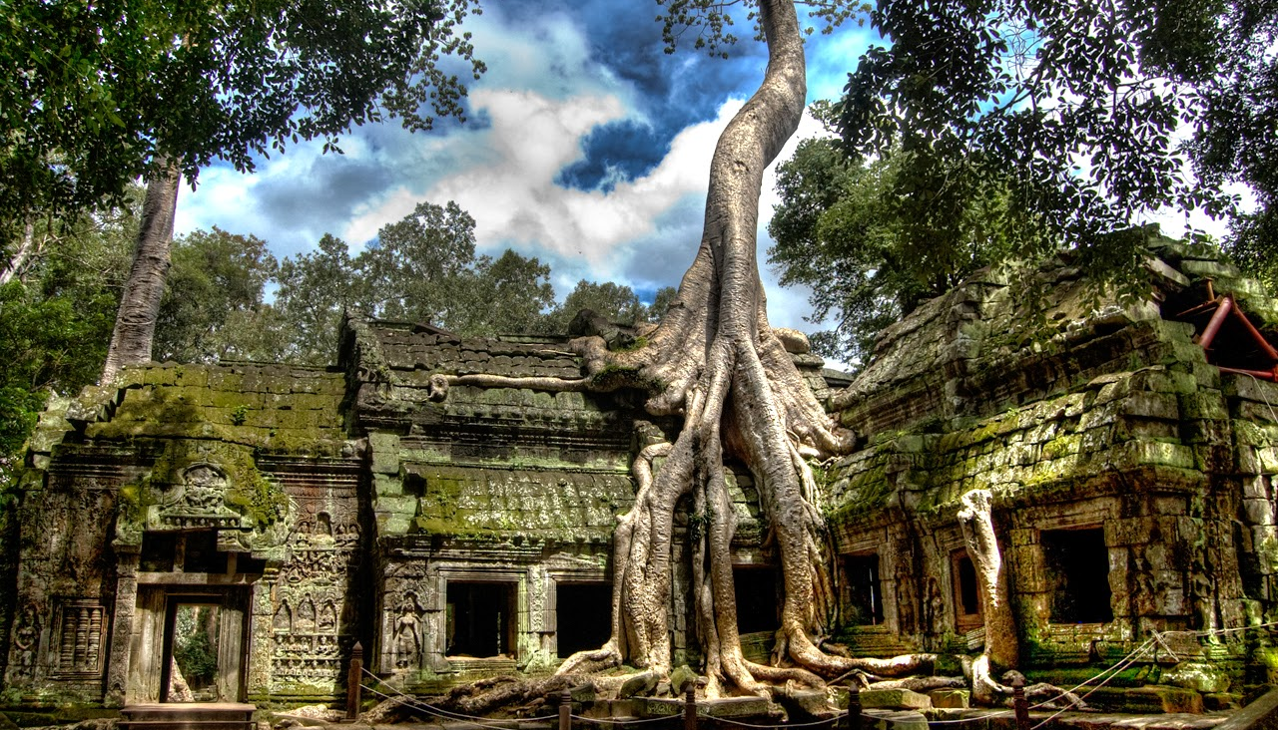
TA PROHM TEMPLE
Notes:
Activities:
Visit Ta Prohm temple, the so-called 'Tomb Raider Temple', Ta Prohm is cloaked in dappled shadow, its crumbling towers and walls locked in the slow muscular embrace of vast root systems

Slide 8
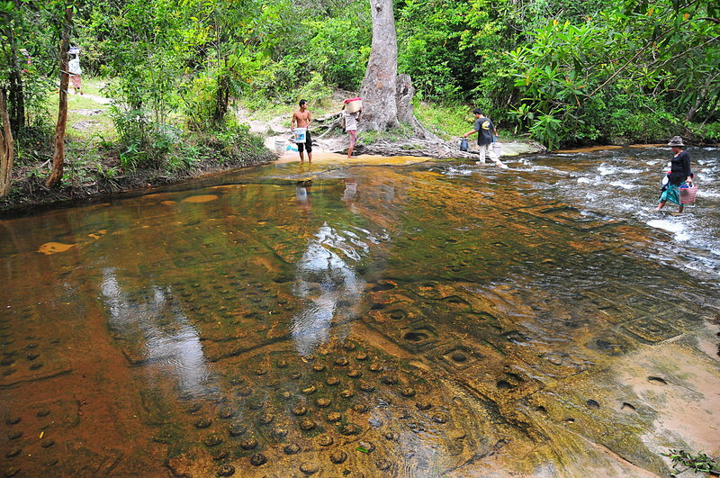
KBAL SPEAN – RIVER OF A THOUSAND LINGAS
Notes:
Activities:
Hiking to Kbal Spean ‘the River of a Thousand Lingas’. It is a 2km uphill walk to the carvings, along a pretty path that winds its way up into the jungle, passing some interesting boulder formations along the way.

Slide 9
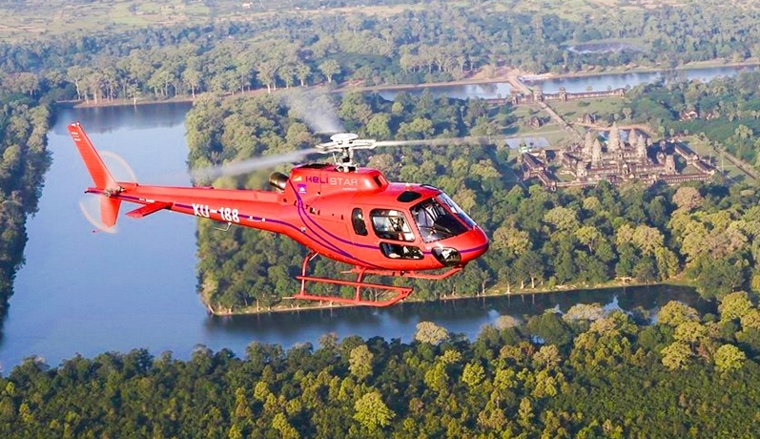
Blessing ceremony at a local monastery
Village-theme dinner at a Khmer village
FLY OVER ANGKOR BY HELICOPTER
Notes:
Activities:
Flying over Angkor by helicopter
Duration: 8minutes – 60 minutes upon on clients’ picked route
Capacity: max 5pax/ scenic flight (no baggage)

Slide 10
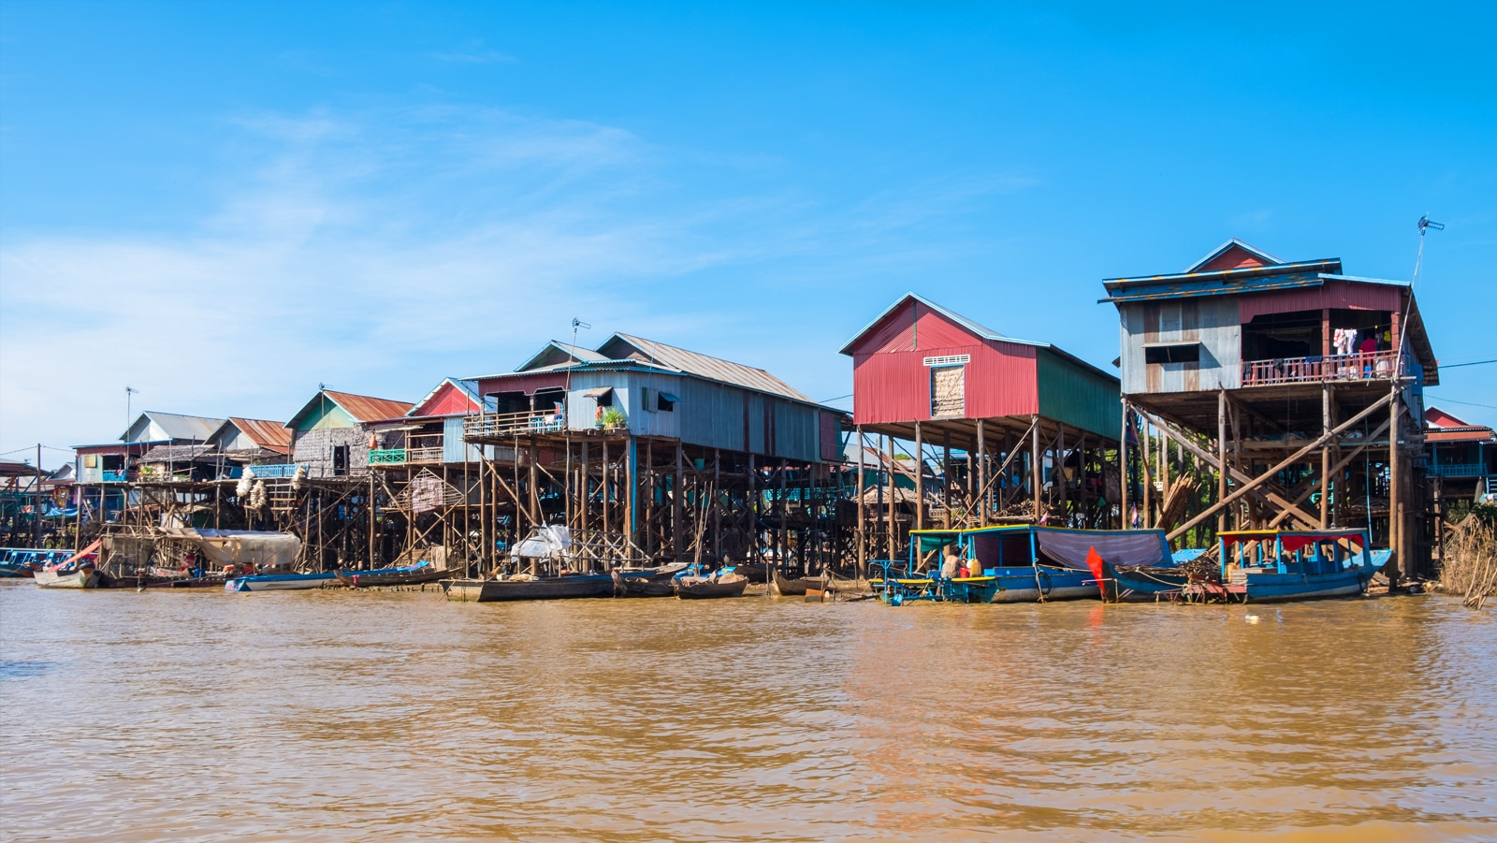
TONLE SAP LAKE
Notes:
Activities:
Take a boat ride on Tonle Sap Lake. It’s the most important lake in Cambodia, supplies fishes to half of the country’s population. There are 04 impressive floating villages:
+, Kampong Pluk, 32km from Siem Reap city center, authentic, less tourist
+, Kompong Khleang, 51km from Siem Reap city center, authentic, less tourist
+, Mechrey, 28km from Siem Reap city center, authentic, popular tourist place
+, Chong Kneas, 17km from Siem Reap city center, popular tourist place

Slide 11
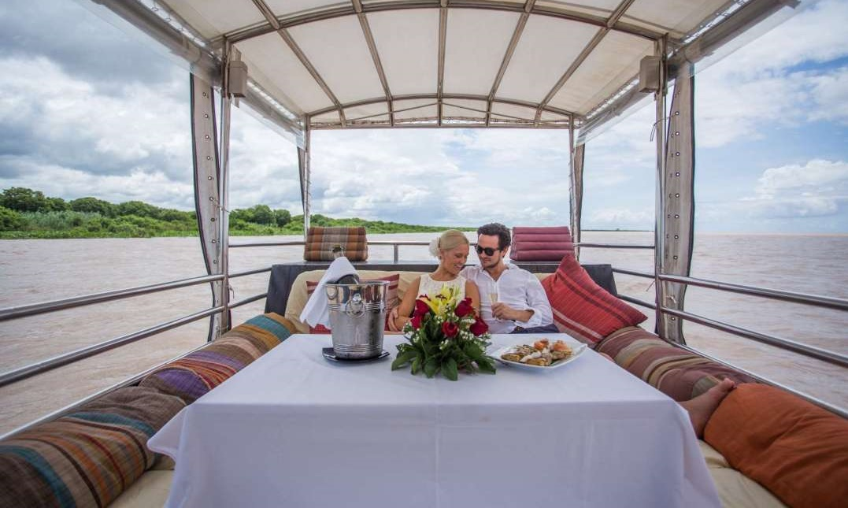
Blessing ceremony at a local monastery
Village-theme dinner at a Khmer village
SUNSET COCKTAIL ON TONLE SAP LAKE
Notes:
Activities:
Luxury sunset cruise on Tonle Sap Lake with cocktail/champagne and canapes

Slide 12
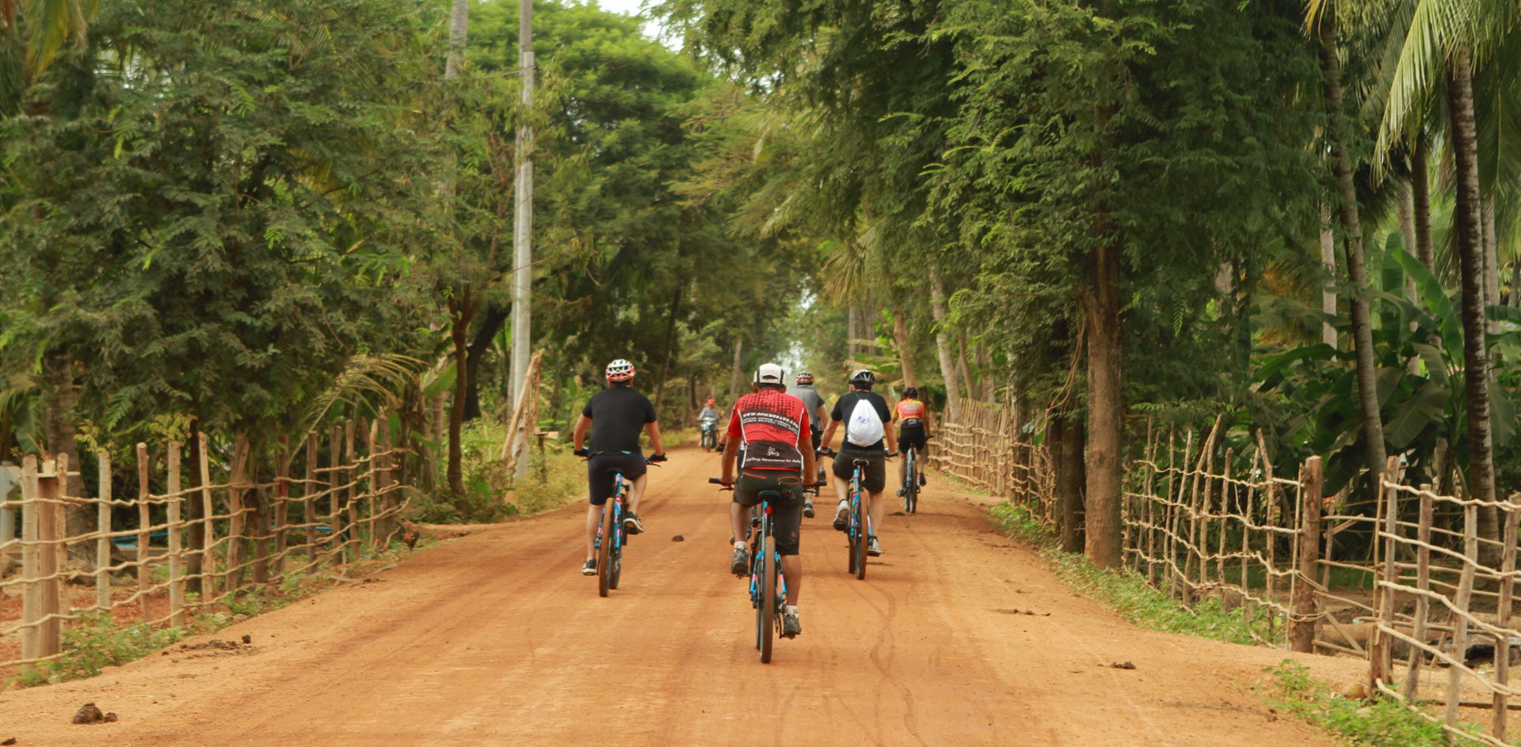
Blessing ceremony at a local monastery
Village-theme dinner at a Khmer village
CYCLING IN THE VILLAGES
Notes:
Activities:
Visit the Khmer villages by bike

Slide 13
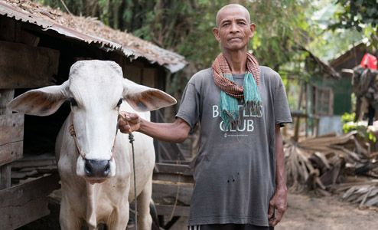
Blessing ceremony at a local monastery
Village-theme dinner at a Khmer village
MEET POL POT SURVIVOR
Notes:
Activities:
Meet a Pol Pot survivor to give you a glimpse of the cruelty of the Khmer Rouge regime and Cambodia History.

Slide 14
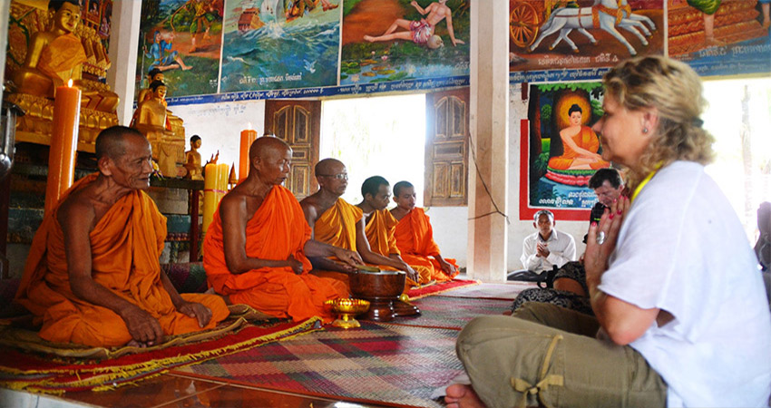
Blessing ceremony at a local monastery
Village-theme dinner at a Khmer village
BLESSING CEREMONY IN MONASTERY
Notes:
Activities:
Blessing ceremony in monastery

Slide 15
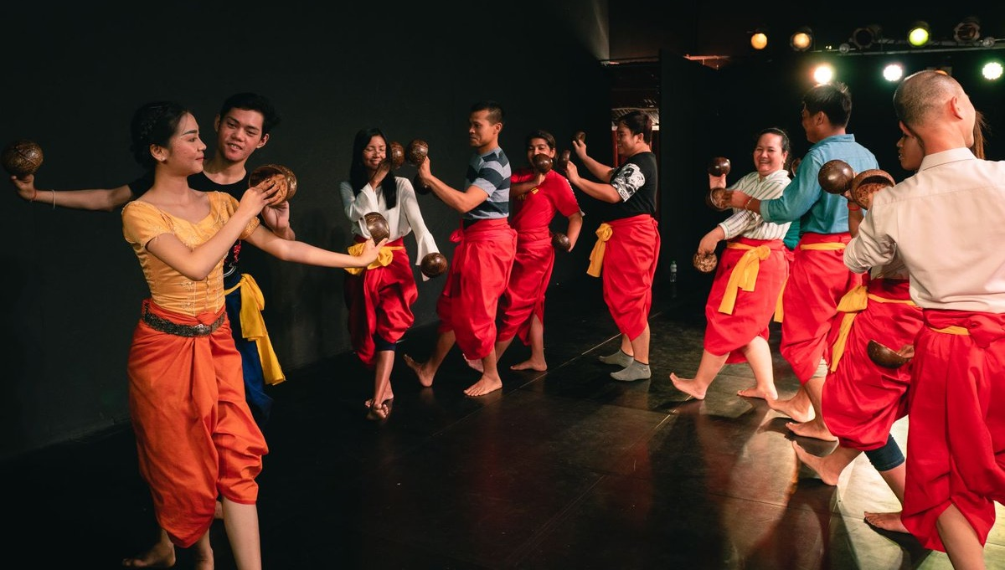
Blessing ceremony at a local monastery
Village-theme dinner at a Khmer village
KHMER TRADITIONAL DANCE
Notes:
Activities:
Traditional Khmer dance school: An exciting and memorable 90-minutes including giving opportunities to interact with the trainers and the children to learn how they preserve the traditional performance arts and watch a performance by the children

Slide 16
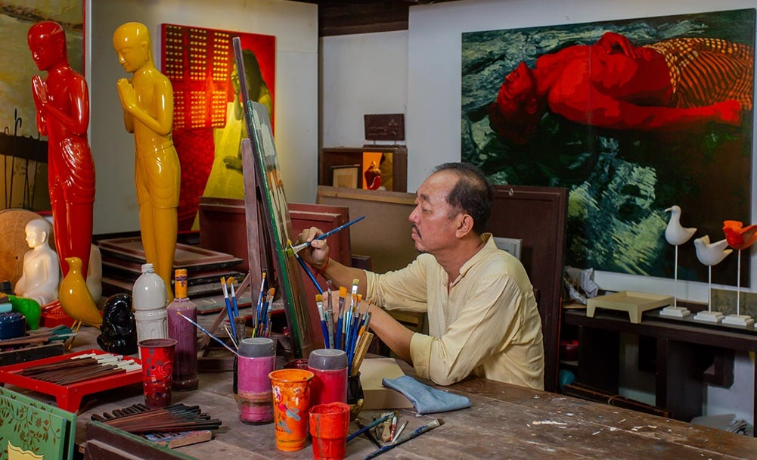
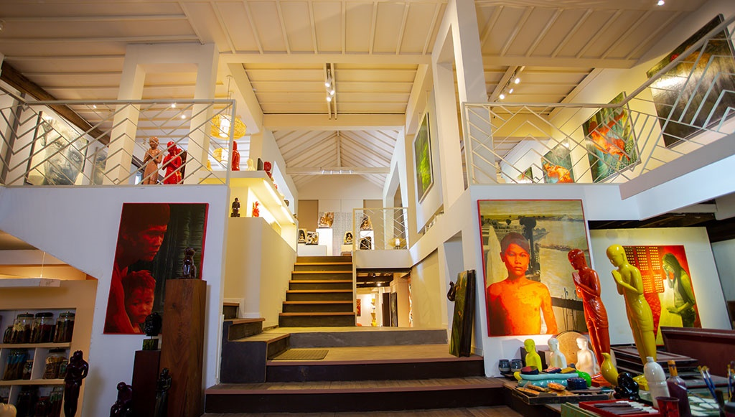
Village-theme dinner at a Khmer village
MEET WELL-KNOWN KHMER ARTIST
Notes:
Activities:
Visit a Khmer Art Gallery and meet a well-known Khmer artist. This is an opportunity to learn more about traditional Khmer art and how it has been revived over the years.

Slide 17
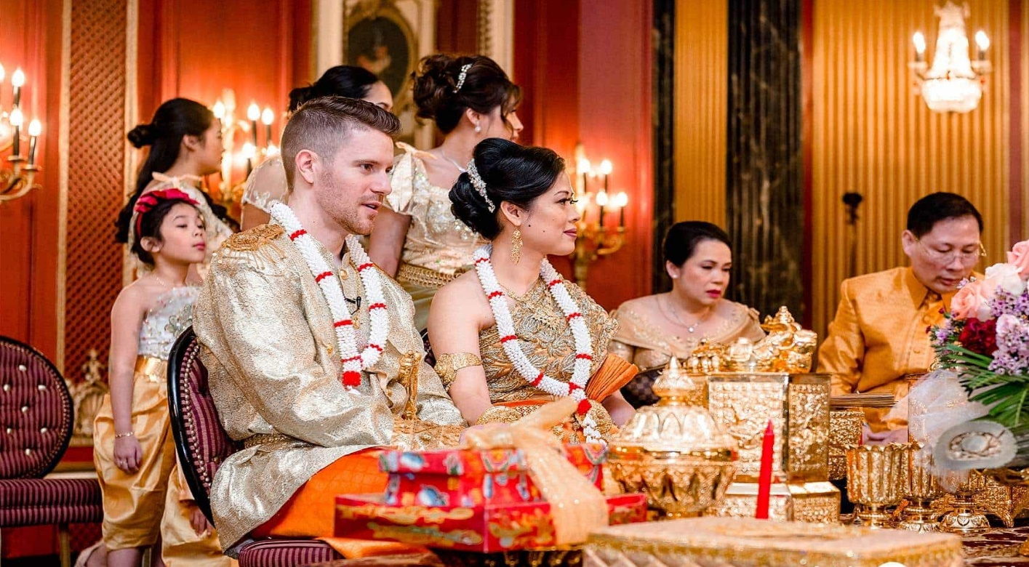
Village-theme dinner at a Khmer village
WEDDING LIKE A KHMER COUPLE
Notes:
Activities:
Pretending wedding like a Khmer couple to know in deep the local custom & tradition

Slide 18
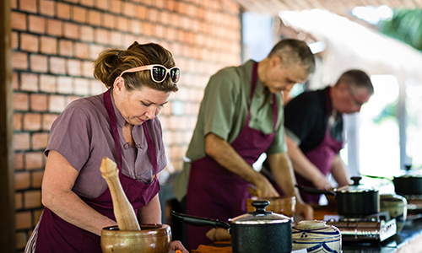
Blessing ceremony at a local monastery
Village-theme dinner at a Khmer village
COOKING CLASS
Notes:
Activities:
Hands-on cooking class with the villagers to know the local cuisines and culture.

Slide 19
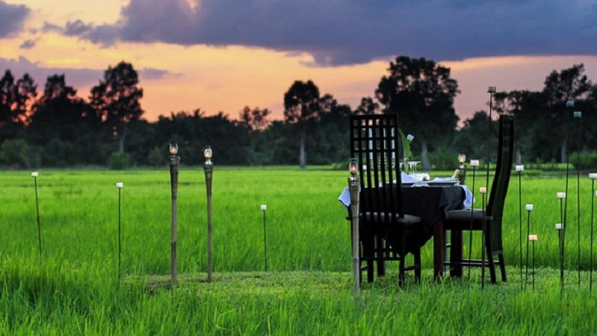
Blessing ceremony at a local monastery
Village-theme dinner at a Khmer village
DINING AMID SECLUDED RICE FIELD
Notes:
Activities:
An exclusive dinner amongst secluded rice field

Slide 20
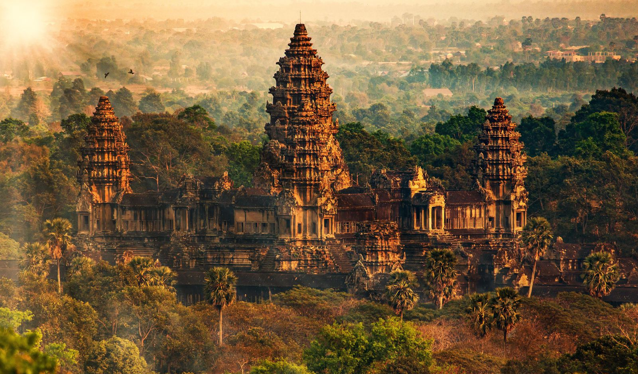
Notes:
360o Photo: After click, be patient for loading…

Slide 21
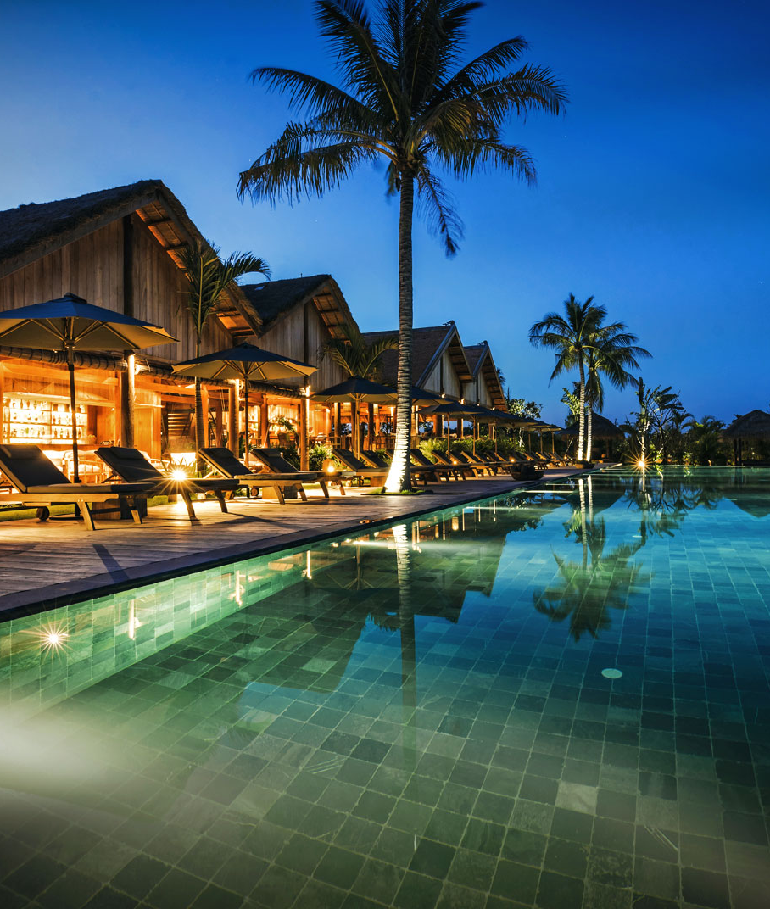
WHERE TO STAY?
Amansara resort (5*)
Belmond La Residence 5*
Phum Baitang Resort 5*
Raffles Grand Hotel D’Angkor
Park Hyatt Siem Reap 5*
Anantara Angkor Resort 5*
Le Meridien Angkor Hotel 5*
Victoria Angkor Resort 5*
Shinta Mani Hotel 5*
Shinta Mani Shack 4*
Notes:
Photo: Amansara resort (5*)

Slide 22
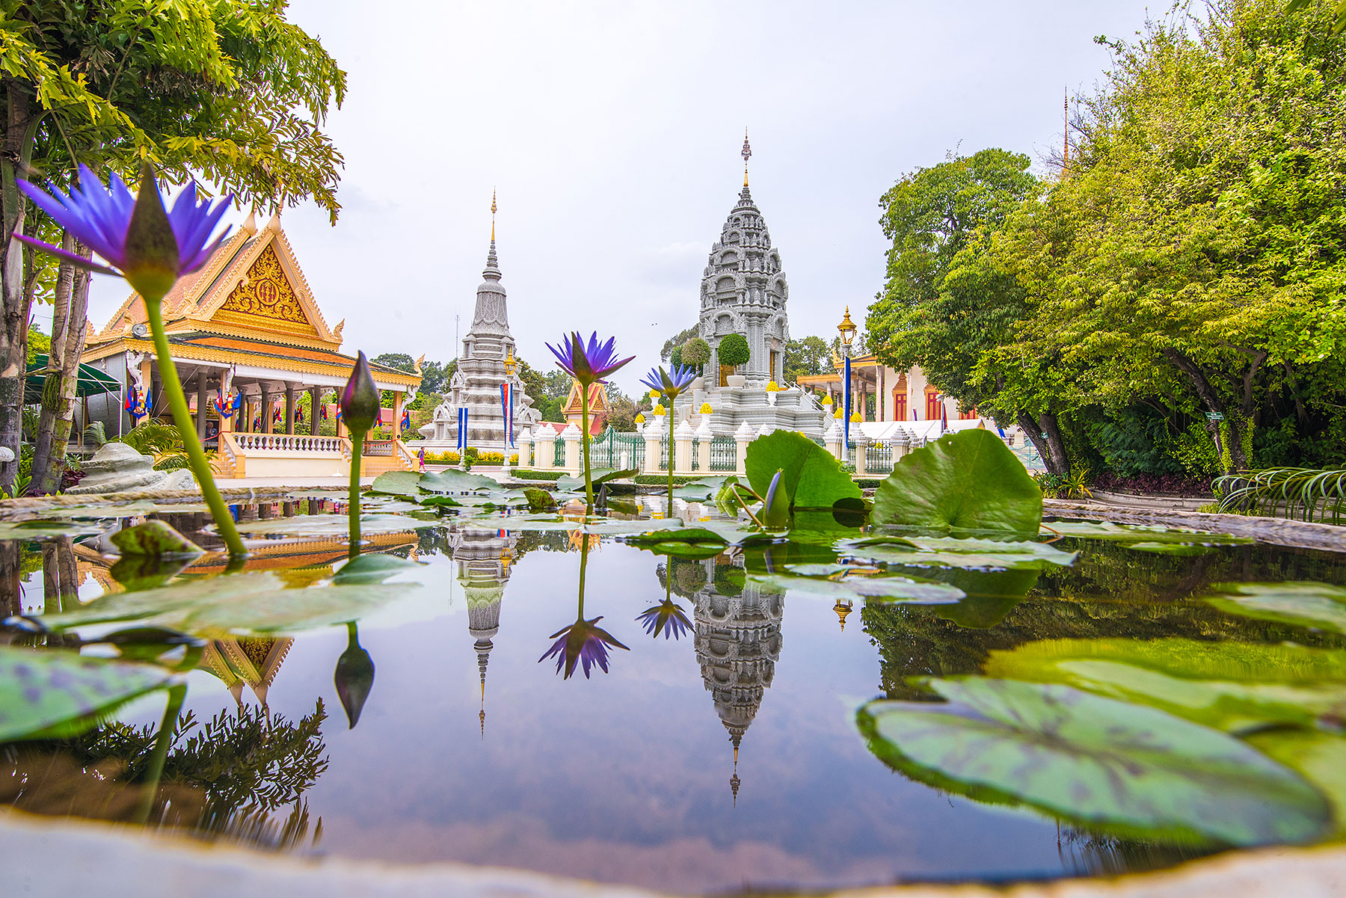
PHNOM PENH CITY
Notes:
PHNOM PENH is a vibrant bustling capital of Cambodia. It exudes a sort of provincial charm and tranquility with French colonial mansions and tree-lined boulevards amidst monumental Angkorian architecture. Phnom Penh is a veritable oasis compared to the modernity of other Asian capitals.
Location: South of Cambodia
Activities:
Visit city highlights: The Royal Palace, the Silver Pagoda and the Killing Fields
Witness French colonial buildings
Watch unique Khmer Shadow puppetry show

Slide 23
Rantanakiri
Siem Reap
Battambang
Phnom Penh
Kep
Sihanoukville

Slide 24
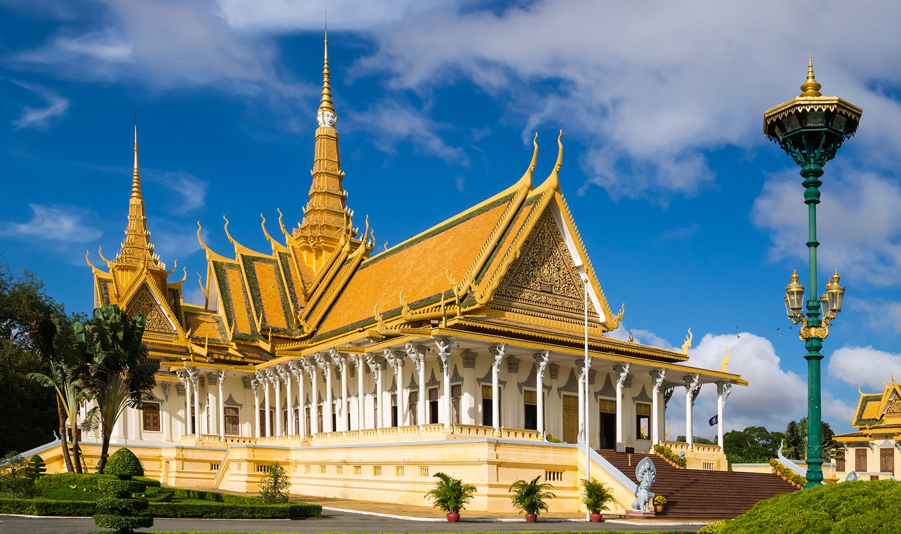
ROYAL PALACE
Notes:
Activities:
Visit city highlights: The Royal Palace, dating to 1866. It includes the official residence of the royal family with parts of the massive palace compound closed to the public, and the Silver Pagoda.

Slide 25
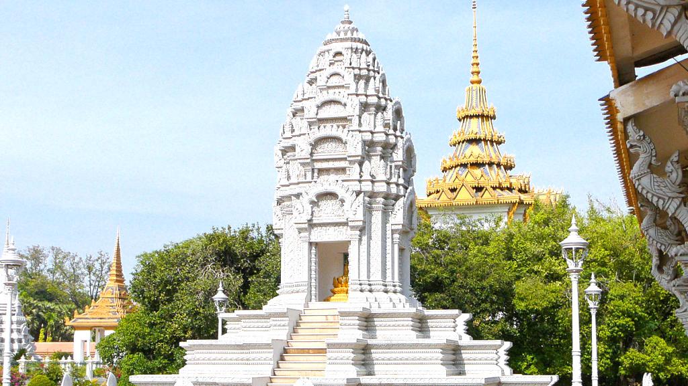
SILVER PAGODA
Notes:
Activities:
Visit city highlights: The Silver Pagoda, covered in 5,000 silver tiles with a diamond-encrusted gold Buddha

Slide 26
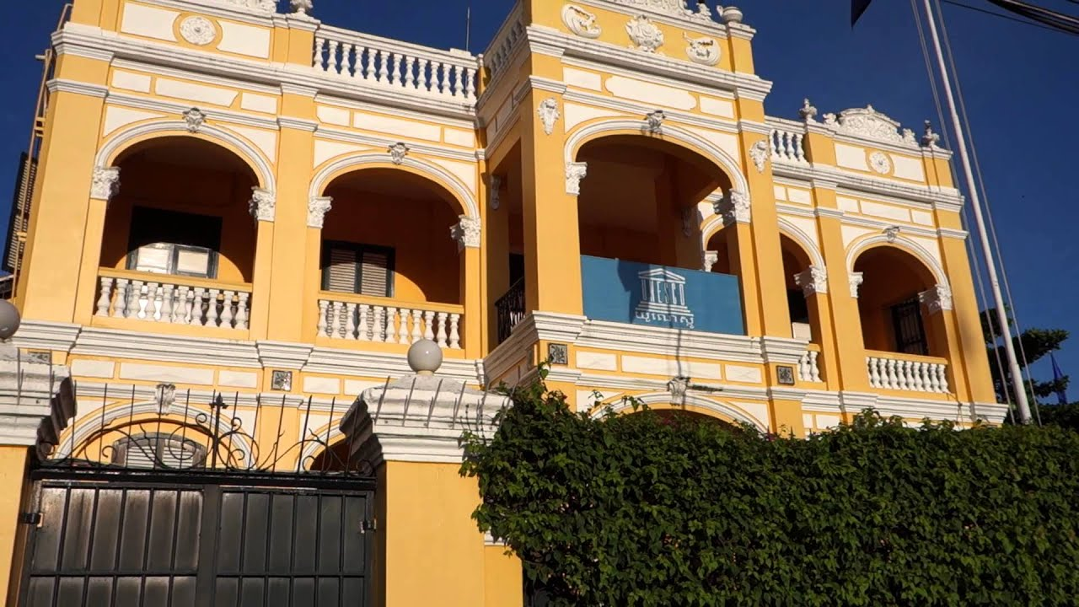
Blessing ceremony at a local monastery
Village-theme dinner at a Khmer village
FRENCH COLONIAL BUILDINGS
Notes:
Activities:
Witness French colonial buildings. From 1867 to 1953, Cambodia was classified as a French protectorate. This was an important time historically for the Kingdom, but it also came to define the architecture of the country

Slide 27
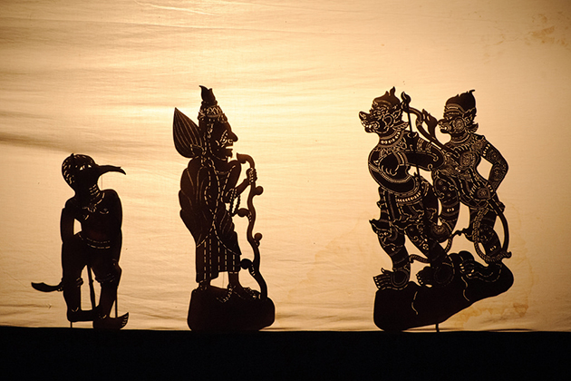
Blessing ceremony at a local monastery
Village-theme dinner at a Khmer village
KHMER SHADOW PUPPETRY SHOW
Notes:
Activities:
Khmer Shadow puppetry show, an unique and sacred Khmer art originated from the 7th Century, featuring the most traditional form of “storytelling”

Slide 28
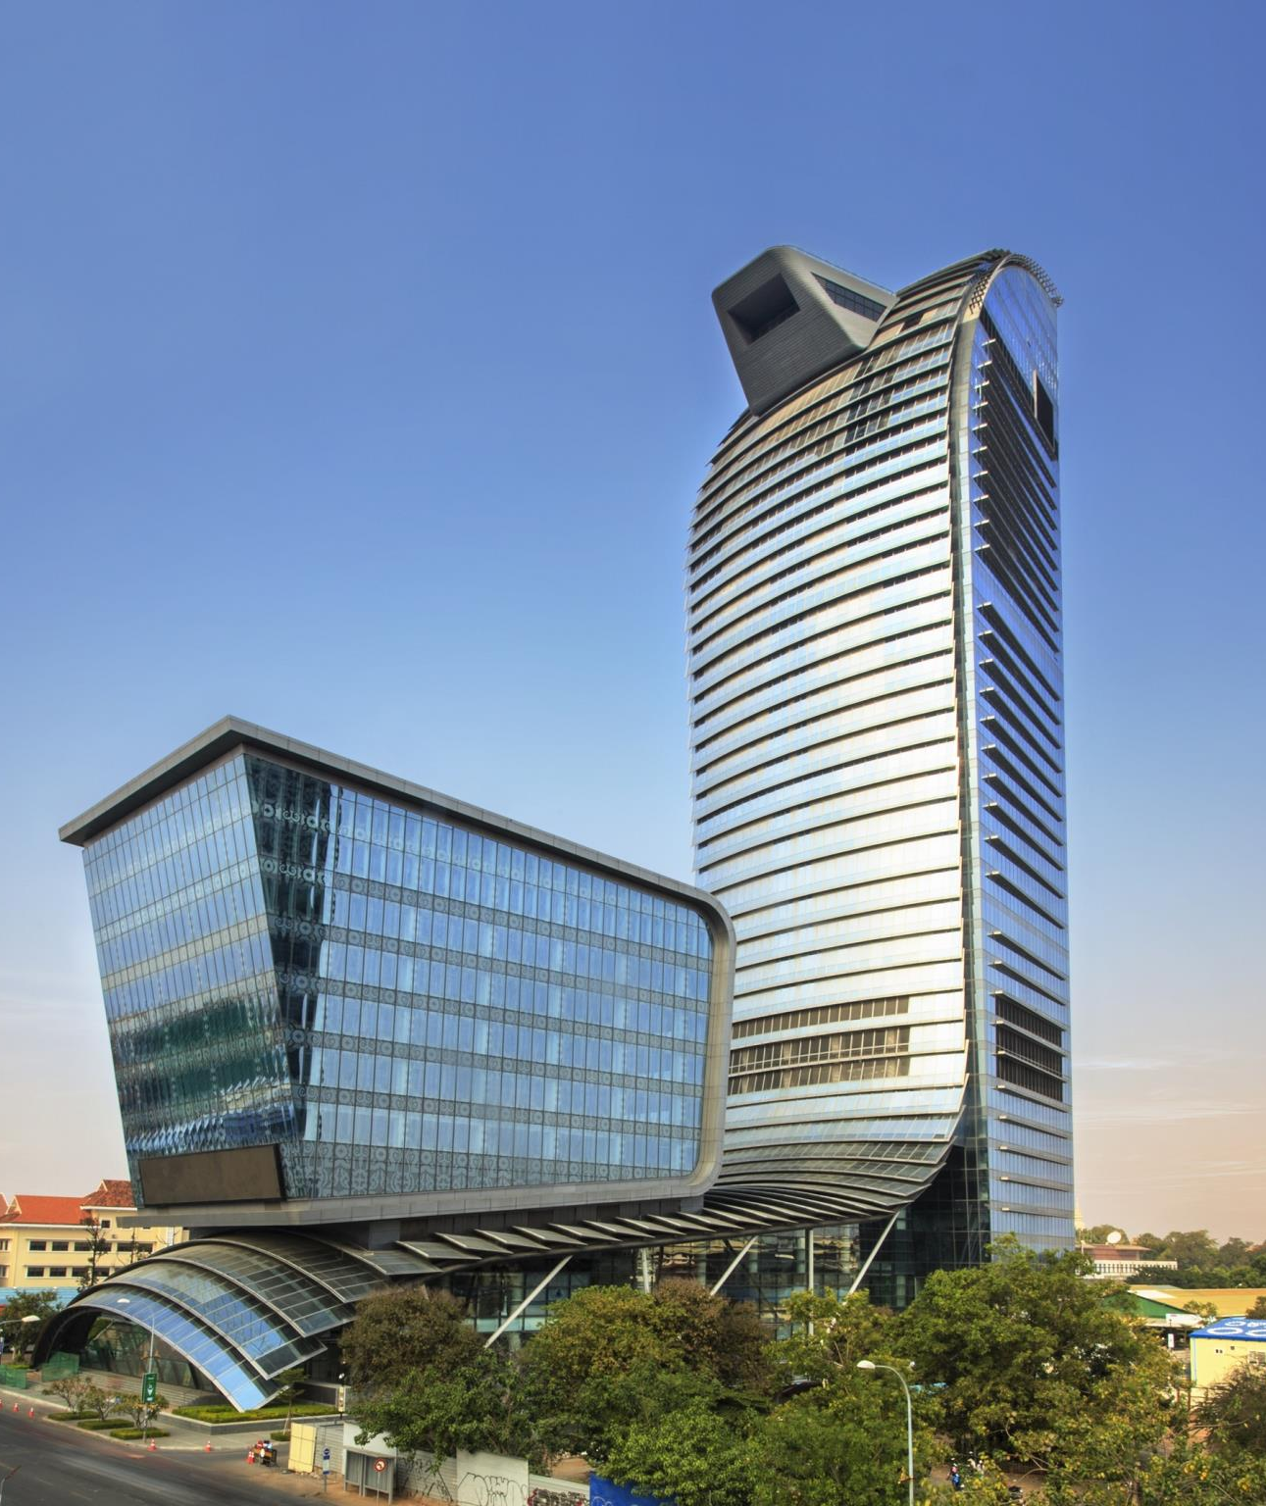
WHERE TO STAY?
Rosewood Phnom Penh 5*
Raffles Hotel Le Royal 5*
Sofitel Phnom Penh Phokeethra 5*
Great Duke Hotel (Old name Intercontinental) 5*
The Bale Phnom Penh Resort 5*
Amanjaya Pancam Suites Hotel 4*
Notes:
Photo: Rosewood Phnom Penh 5*

Slide 29
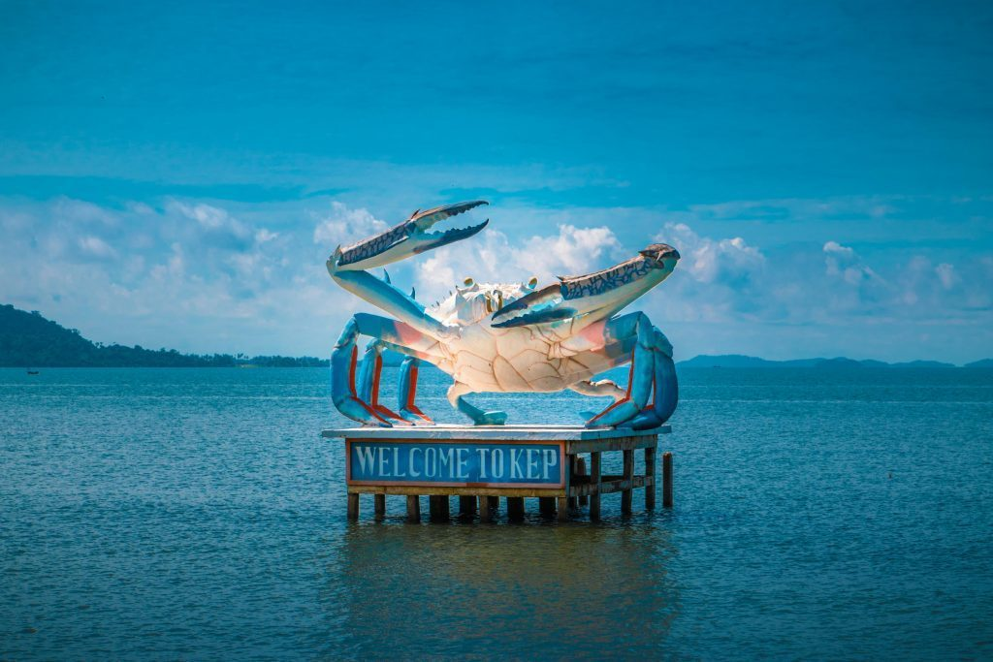
KEP PROVINCE
Notes:
KEP, a sleepy seaside town in the south of Cambodia,
Location: 3-hour drive from Phnom Penh City and 30 minutes to land border checkpoint to Ha Tien province, gateway to Mekong delta and Phu Quoc Island, Vietnam.
Unique points: unspoiled seashore, well-known crab market, seaside crabs shacks, pepper farms, extensive National Park
Limitation: have only a single, kilometer long crescent of sand near the tip of the peninsular

Slide 30
Rantanakiri
Siem Reap
Battambang
Phnom Penh
Kep
Sihanoukville

Slide 31
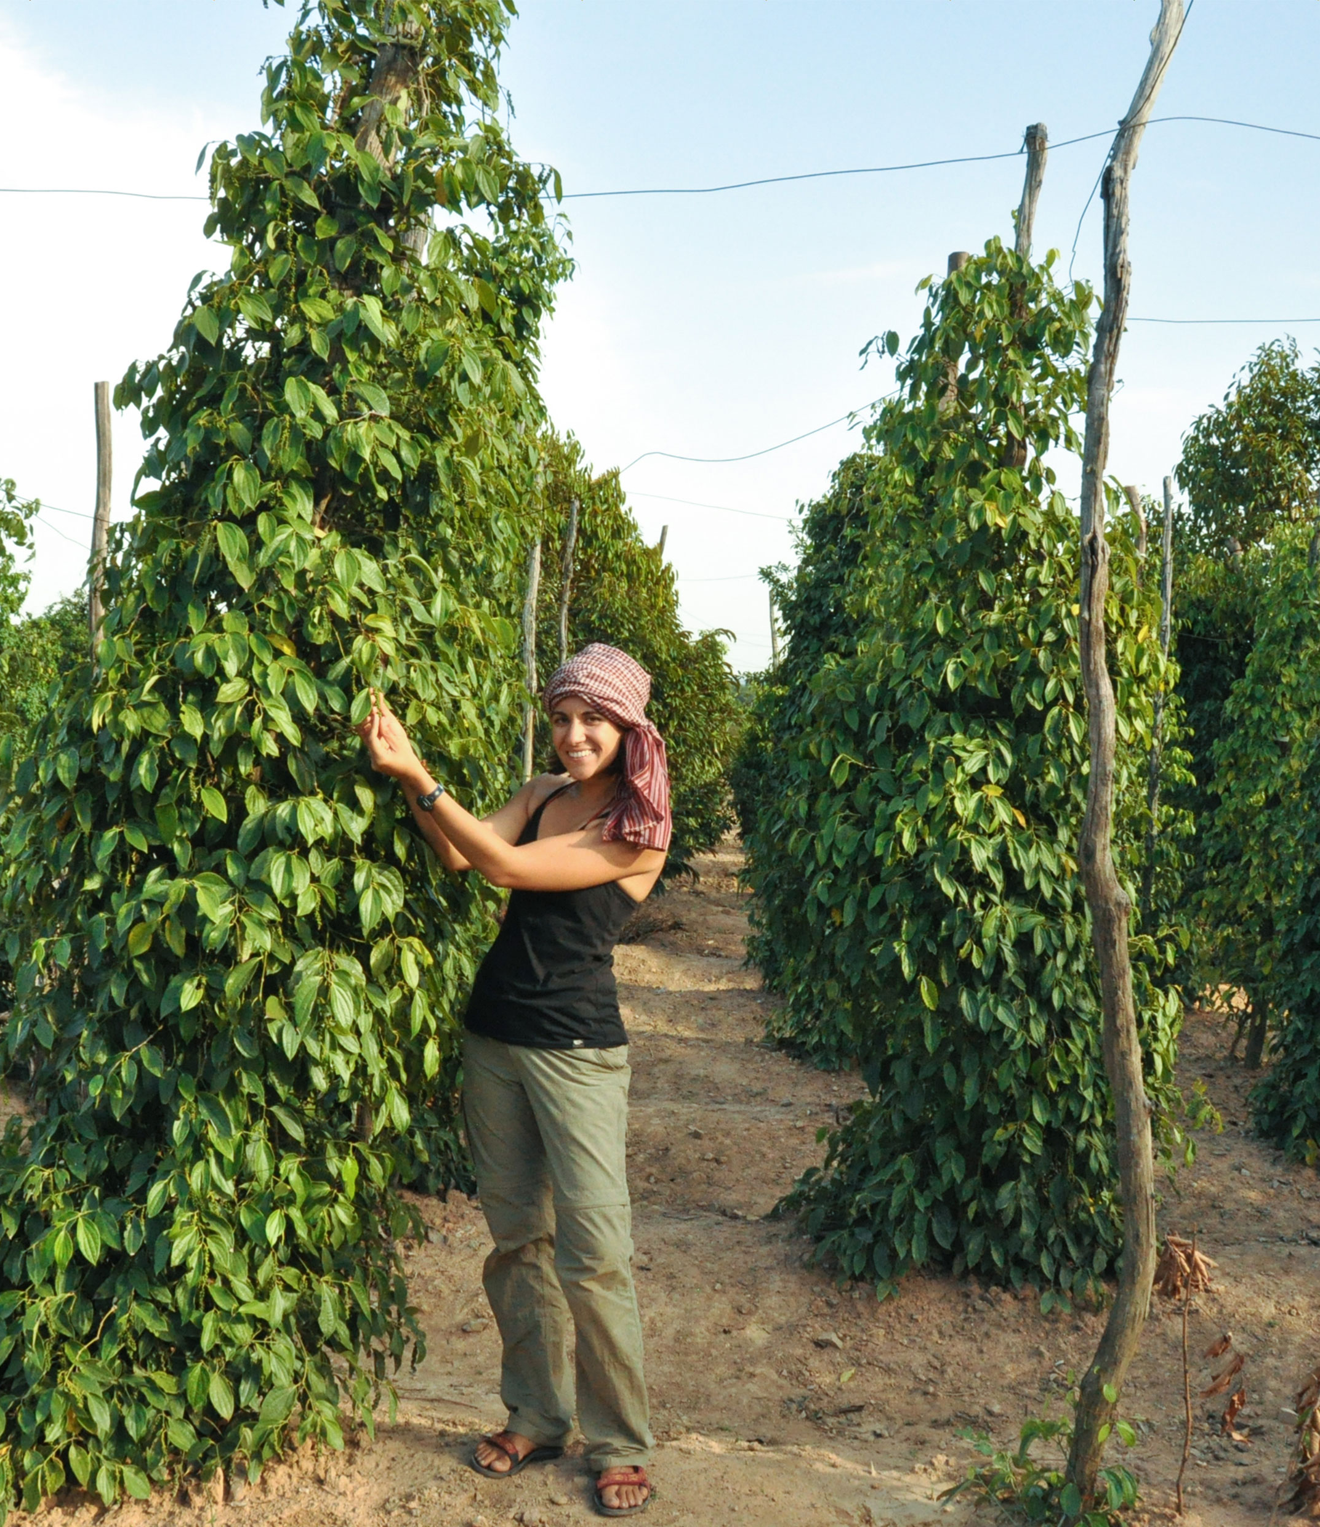
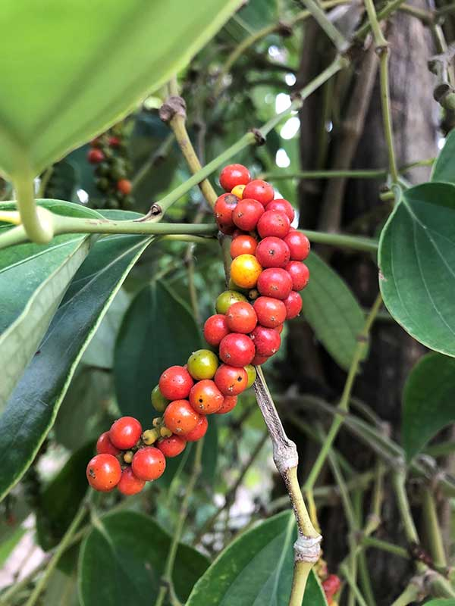
KAMPOT PEPPER PLANTATIONS
Notes:
Activities:
Visit abundant pepper plantations in Kep and Kampot province 24km away from Kep province. Kampot pepper is the World best pepper with strong and delicate aroma.

Slide 32
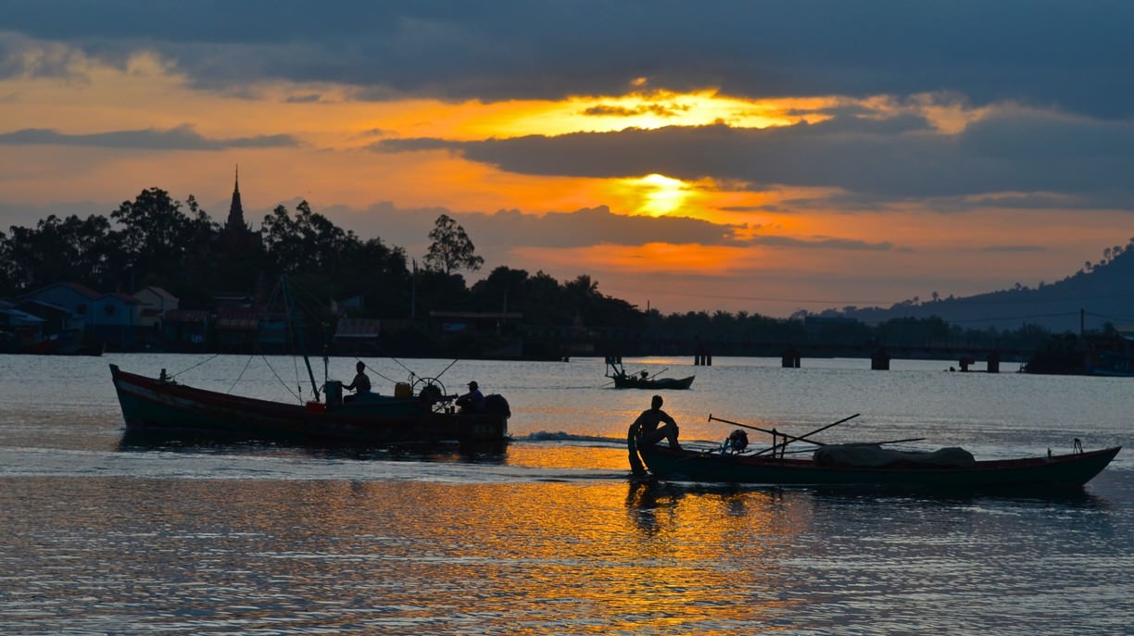
MORNING CRAB MARKET - KEP
Notes:
Activities:
Get up early for a lively crab market. While most Asian markets lore you in with colorful fruits and elaborate displays of local produce, this market has one purpose: seafood. It’s giving us chances to see the local fisherman carrying in the day’s catch, the trading activity and fresh seafood being cooked in the market.

Slide 33
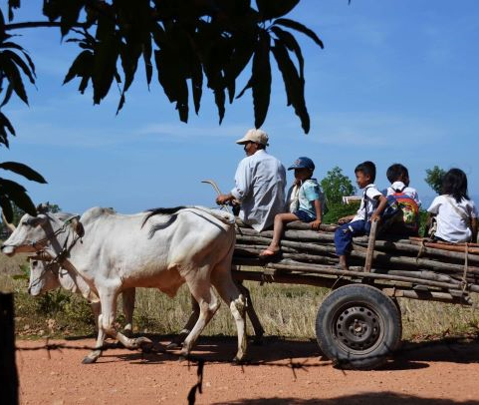
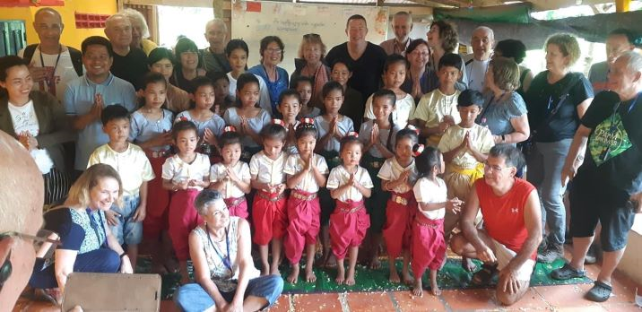
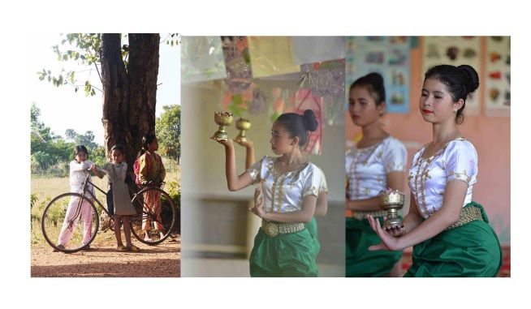
ENCOUNTER WITH CHILDREN IN A NGO
Notes:
Activities:
Visit a local NGO that committed to the training and education of poor children in a rural Cambodian community. Meet & talk with the NGO founder and encounter with children.

Slide 34
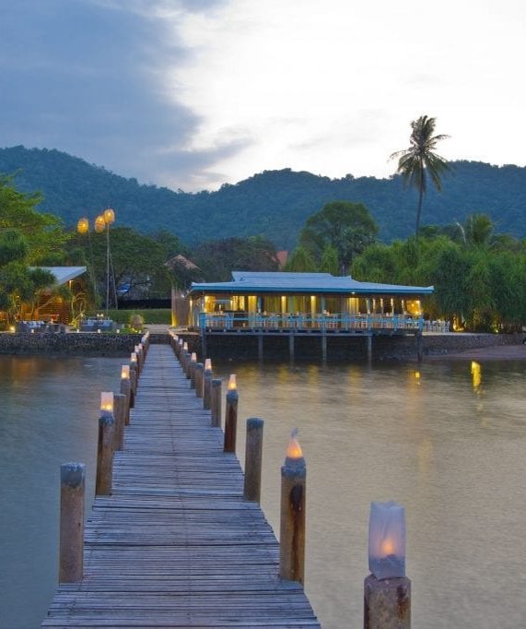
WHERE TO STAY?
Knai Bang Chatt 5*
Veranda Natural Resort 4*
Notes:
Photo: Knai Bang Chatt 5*

Slide 35
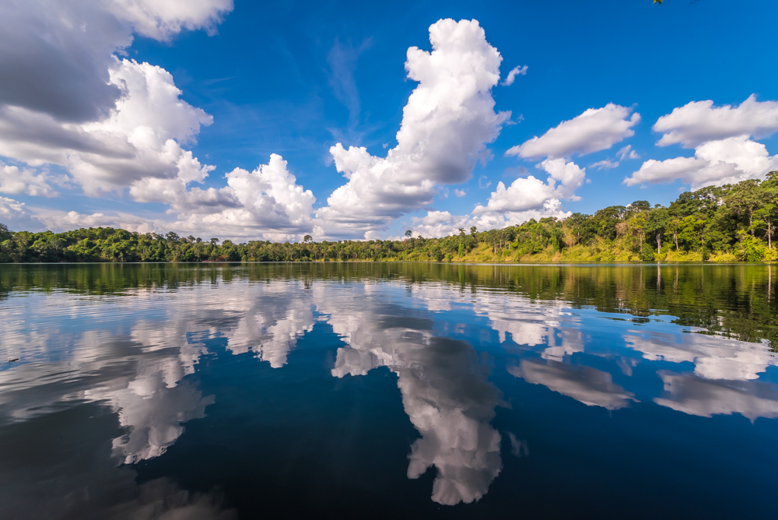
RATANAKIRI PROVINCE
Notes:
RATANAKIRI, remote area, off-the-beaten path destination.
Location: Eastern of Cambodia, 464km (8.5hrs drive) from Siem Reap City, 636km (10hr drive) from Phnom Penh capital city.
Unique points: undulating hills and mountains, wildlife, waterfalls and authentic ethnic groups
Activities:
Visit stunning waterfalls in Ban Loung district
Encounter with Asia Elephants in Lumphat Wildlife Sanctuary, south of Ban Loung
Hiking and rafting on the river

Slide 36
Rantanakiri
Siem Reap
Battambang
Phnom Penh
Kep
Sihanoukville

Slide 37
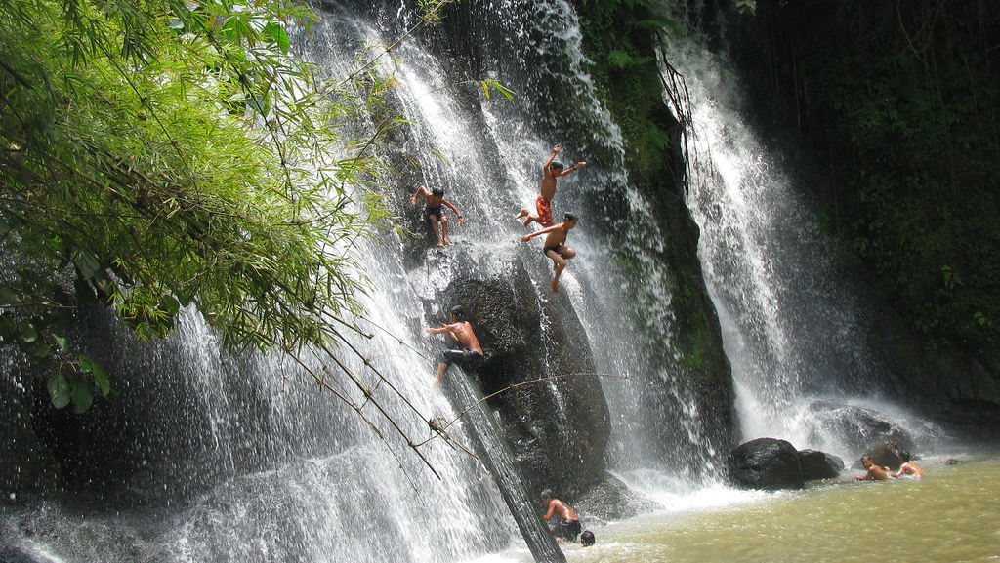
STUNNING WATERFALLS
Notes:
Activities:
Visit stunning waterfalls in Ban Loung district

Slide 38
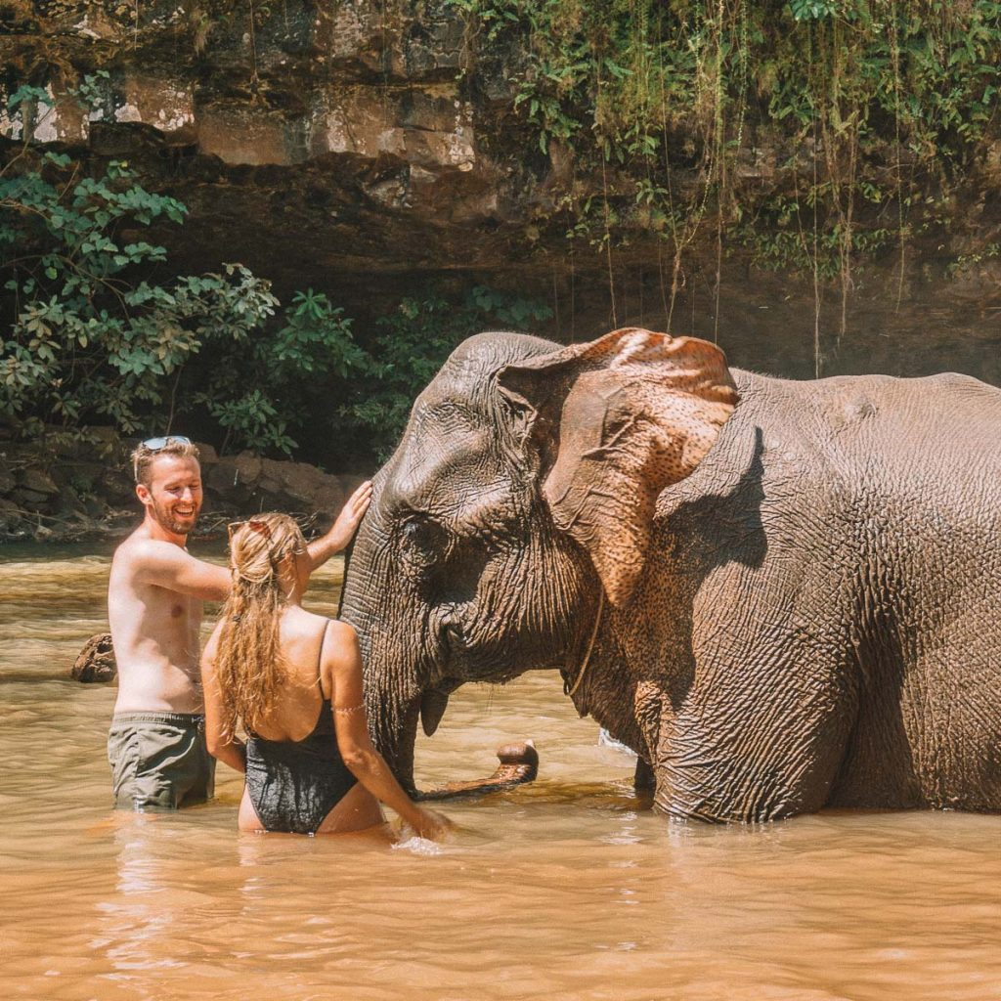
ENCOUNTER WITH ASIA ELEPHANTS
Notes:
Activities:
Encounter with Asia Elephants in Lumphat Wildlife Sanctuary, south of Ban Loung

Slide 39
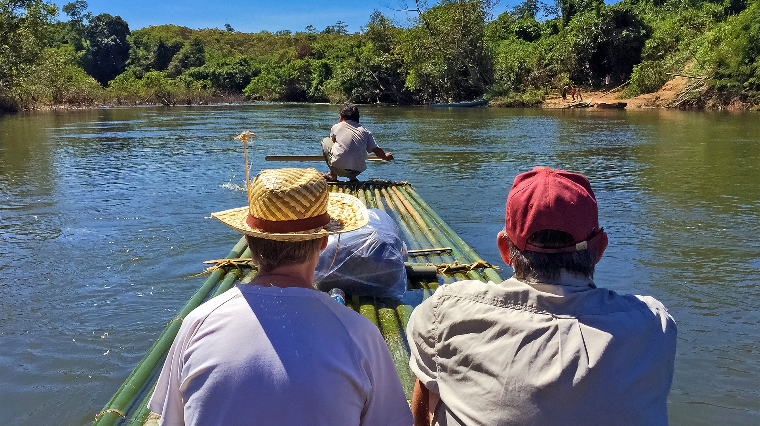
RAFTING ON THE RIVER
Notes:
Activities:
Hiking and rafting on the river

Slide 40
TREKKING IN THE FOREST
Notes:
Activities:
Hiking and rafting on the river

Slide 41
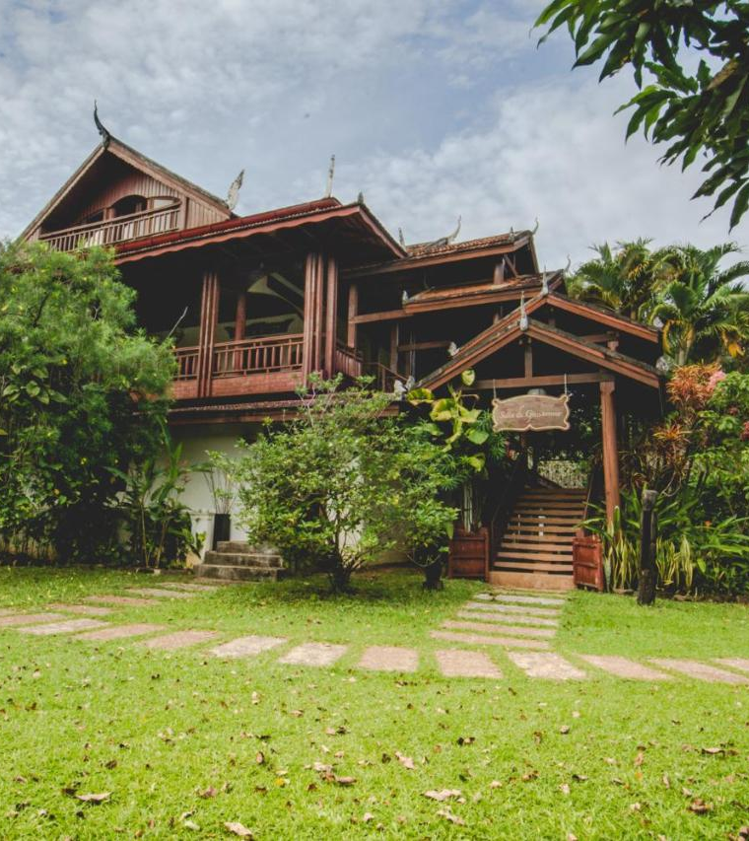
WHERE TO STAY?
Terres Rouges Lodge 4*
Yeak Loam Hotel 4*
Notes:
Photo: Yeak Loam Hotel 4*

Slide 42
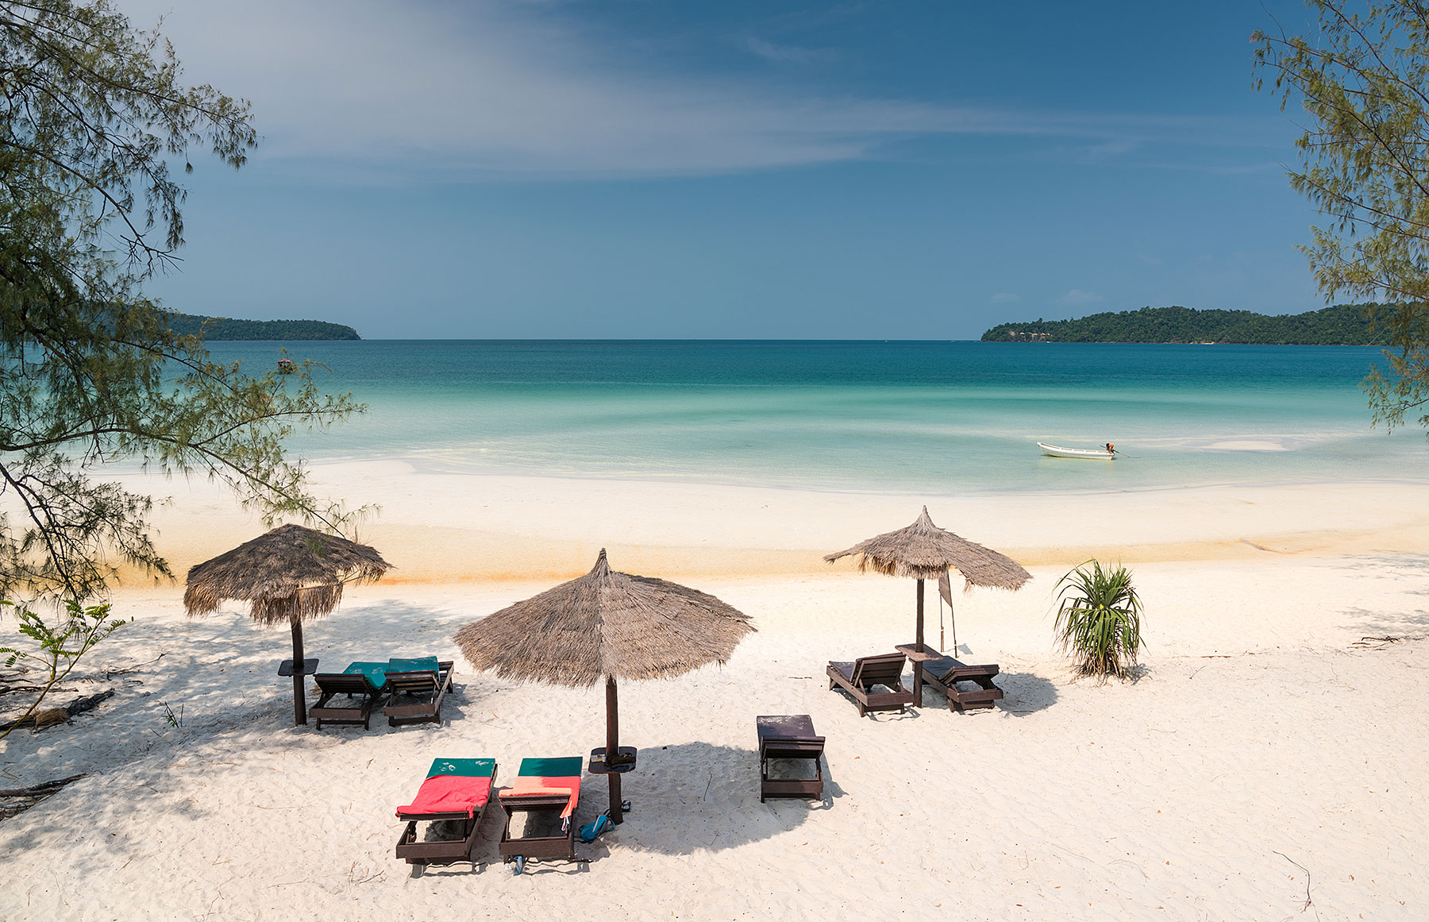
SIHANOUKVILLE and ISLANDS SURROUNDING
Notes:
SIHNAOUKVILLE:
Location: Southwest of Cambodia, 221km (4.5 hour drive) from Phnom Penh City or 1 hour flight from Siem Reap City
Well-known for small offshore Islands with beautiful beaches and unexplored dive sites. The most gorgeous are Koh Krabey Island and Koh Rong Island
Activities:
Scuba diving/ snorkeling
Sea kayaking

Slide 43
Rantanakiri
Siem Reap
Battambang
Phnom Penh
Kep
Sihanoukville

Slide 44
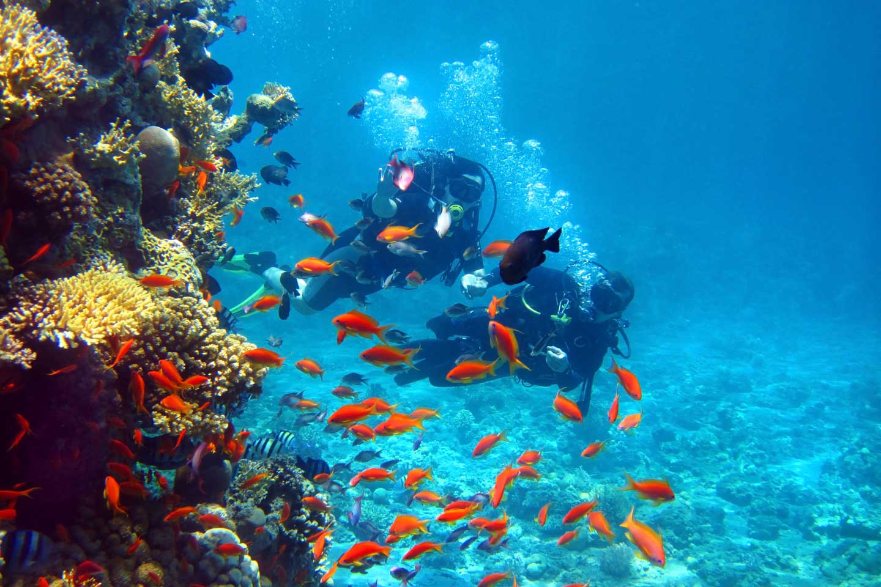
SCUBA DIVING
Notes:
Activities:
Scuba diving/ snorkeling

Slide 45
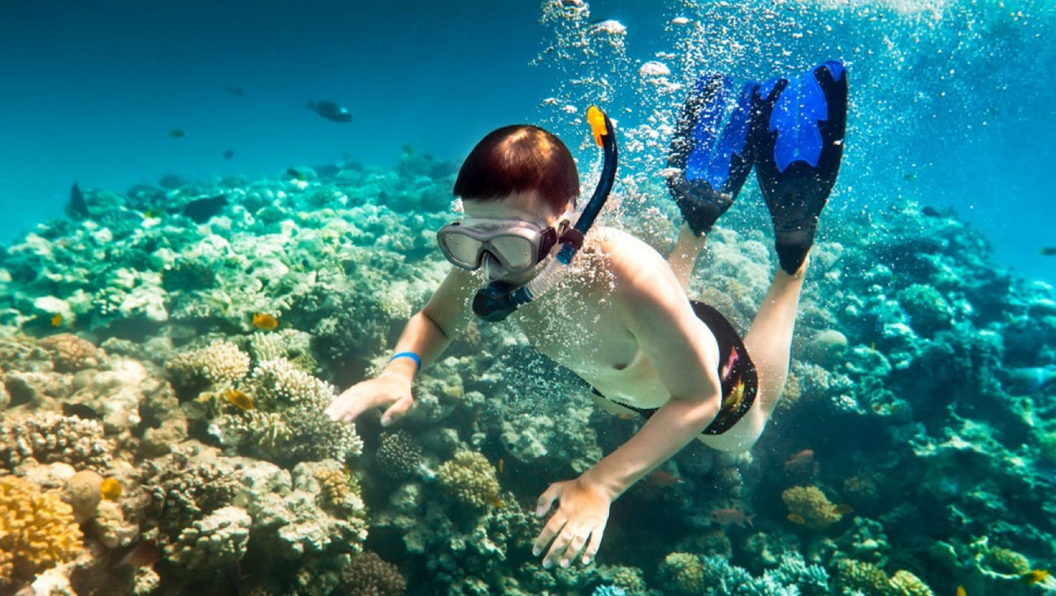
SNORKELING
Notes:
Activities:
Scuba diving/ snorkeling

Slide 46
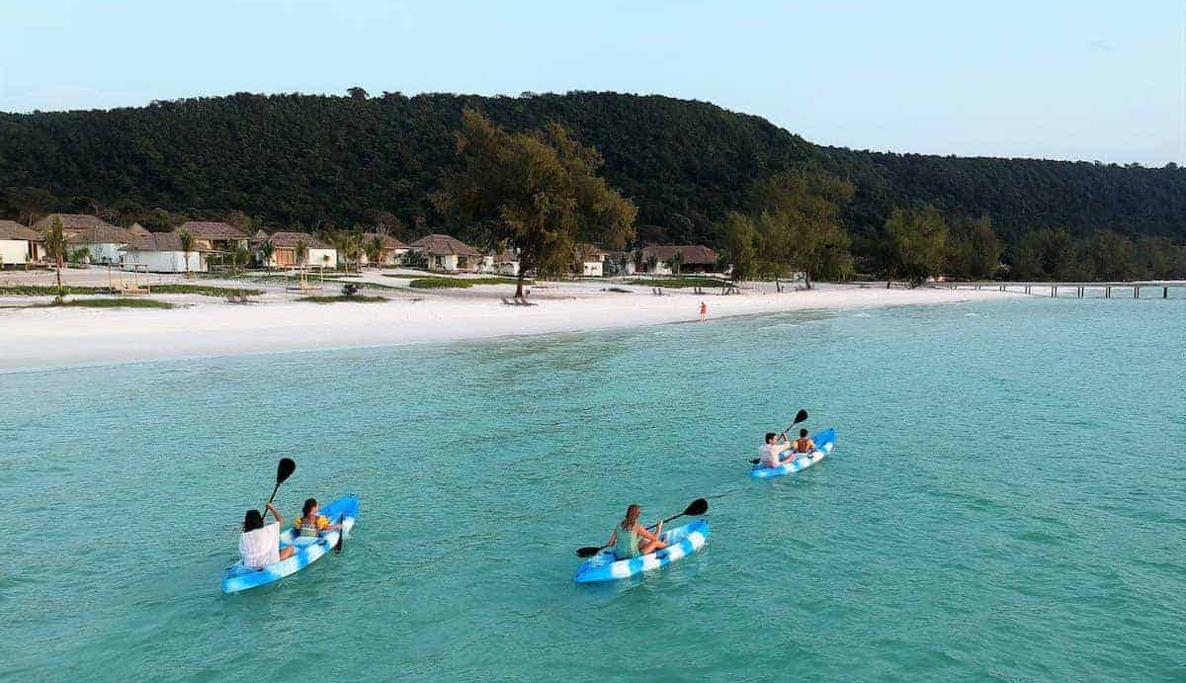
SEA KAYAK
Notes:
Activities:
Sea kayaking

Slide 47
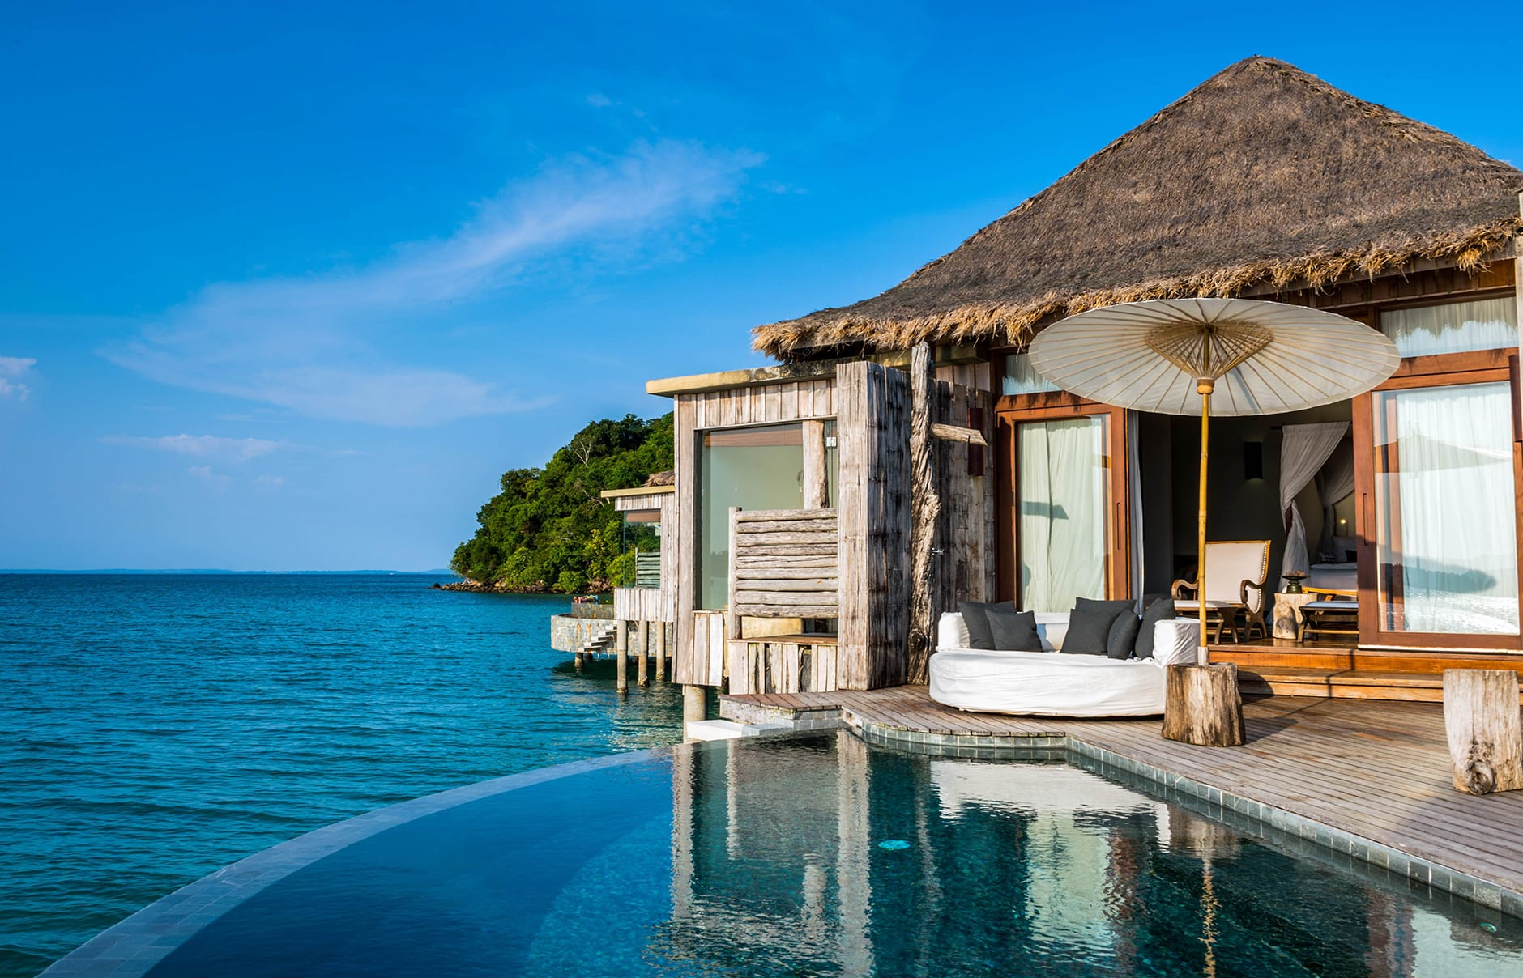
WHERE TO STAY?
Six Senses Krabey Island: on Krabey Island
Song Saa Private Island: a private island resort 5*
The Royal Sands Koh Rong 5: on Koh Rong Island
Sok San Beach Resort 4*: on Koh Rong Island
Notes:
All resorts required a drive from Shihanook Ville airport and speed boat transfer
Photo: Song Saa Private Island

Slide 48
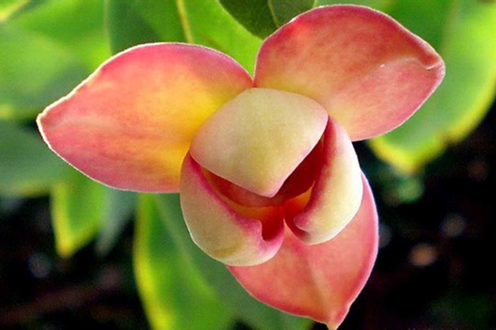
GENERAL INFORMATION
Visa requirement
Weather & When to go
How to reach Cambodia
Logistic
Notes:
National flower of Cambodia – Rumdul flower. Rumdul flower's cientific name is Mitrella mesnyi

Slide 49
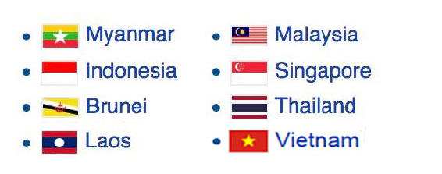
Visa requirement
Passport:
A minimum validity of 6 months
Have at least one and a half blank pages
Visa:
Visa on Arrival is the most convenience way.
03 international airports: Phnom Penh, Siem Reap & Sihanoukville
12 international land border gates with Vietnam, Thailand & Laos
Also travelers can apply for E-visa before departure
NO VISA REQUIREMENT WITHIN 14 - 30 DAYS
Notes:
Due to Covid, the term and condition may change without prior notice
Please consult with AURORA TRAVEL TEAM for update

Slide 50
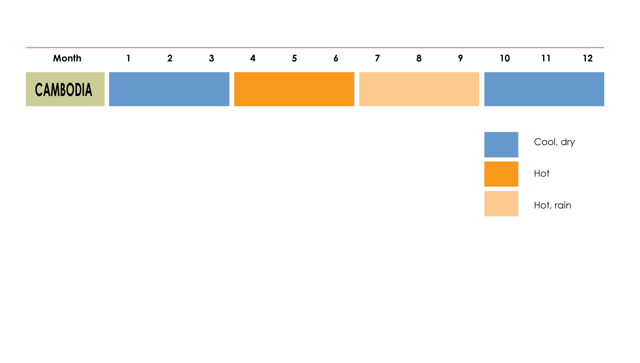
Weather & When to go
Best time: October till March (note to avoid Chines New Year either in Jan or Feb)
Summer: April and May are the hottest months but Thai Songkran (Thai New Year) is in the middle of Apr (13 to 16)
Rainy Season: Jun to September (monsoons)
Notes:
Cambodia:
Best travel months : Jan, Feb, Mar, Oct, Nov & Dec. Dry season, cool climate. Average 20ºC – 32ºC
Shoulder season : Apr to Jun. Beginning of raining season. Hottest months of the year. Average 32ºC – 35ºC
Raining season : from Jul to Sept. Middle of raining season, high rainfall and hot. Average 25ºC – 32ºC

Slide 51
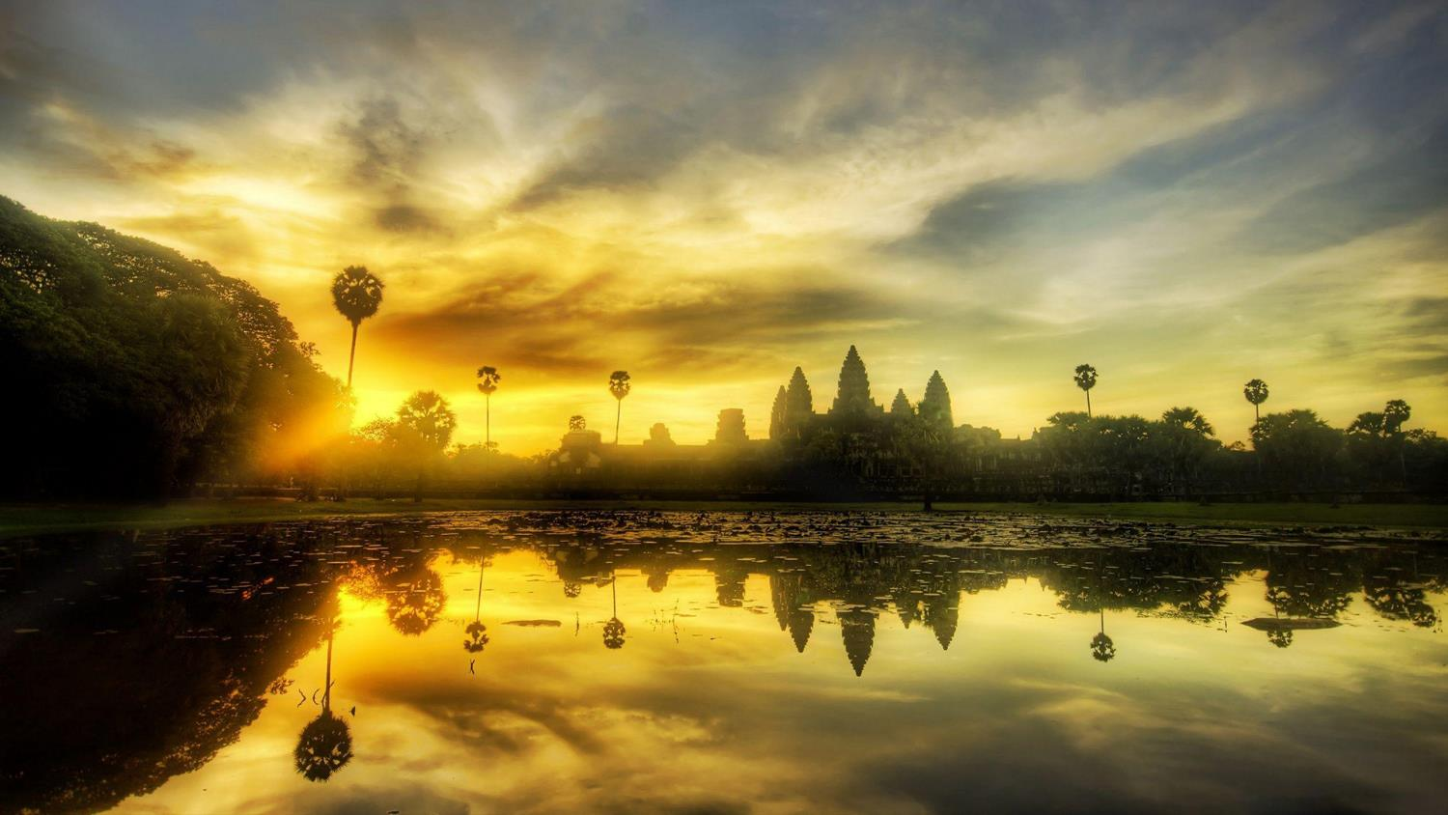
CARS
4 seater
7 seater
29 seater
for your attention
16 seater
Please contact us for more information sale@auroratravel.asia
45 seater

